Slide 1
Python Django
江琳

Slide 2
Overview
Part one:
Python
Part two:
Django

Slide 3
github
https://github.com/edu2act/course-python-django

Slide 4
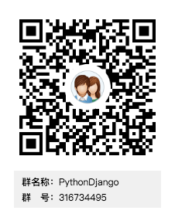

QQ

Slide 5
雪梨教育
http://www.edu2act.cn/team/PythonDjango/application/

Slide 6
Overview

Slide 7
Python Overview
江琳

Slide 8
Python Overview
Python is an easy to learn, powerful programming language. It has efficient high-level data structures and a simple but effective approach to object-oriented programming.
You can use it to create web apps, games, even a search engine!

Slide 9
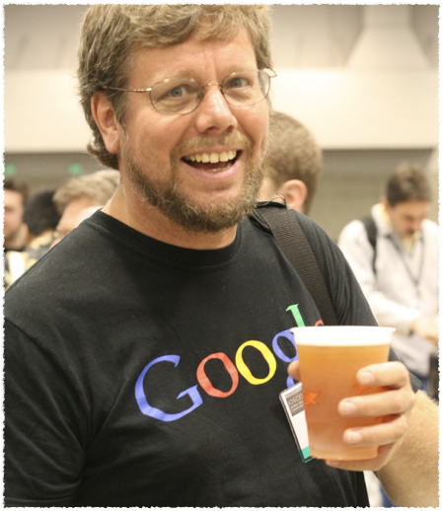
Python History
1989 Christmas, release at 1991
Developed by Guido van Rossum
A big fan of Monty Python’s Flying Circus

Slide 10
Python Features
High-level Language:
When you write programs in Python, you never need to bother about the low-level details such as managing the memory used by your program.

Slide 11
Python Features
Interpreted
Python does not need compilation to binary. You just run the program directly from the source code.

Slide 12
Python Features
Free and open source
You can freely distribute copies of this software, read it's source code, make changes to it, use pieces of it in new free programs, and that you know you can do these things.

Slide 13
Python Features
A Broad Extensive Library
The Python Standard Library is huge indeed. All this is available wherever Python is installed. This is called the ‘Batteries Included’ philosophy of Python.
Besides the standard library, there are various other high-quality libraries

Slide 14
Python Features
Portable
Due to its open-source nature, Python has been ported to many platforms.
You can use Python on Linux, Windows, FreeBSD, Macintosh, Solaris and so on.

Slide 15
Python Features
Extendable
If you need a critical piece of code to run very fast or want to have some piece of algorithm not to be open, you can code that part of your program in C or C++ and then use them from your Python program.

Slide 16
Python Version
Python 2
Python 3
Python 2.x is legacy, Python 3.x is the present and future of the language.

Slide 17
Getting Python
Download from https://www.python.org/

Slide 18
Installing Python
Python distribution is available for a wide variety of platforms. You need to download only the binary code applicable for your platform and install Python.

Slide 19
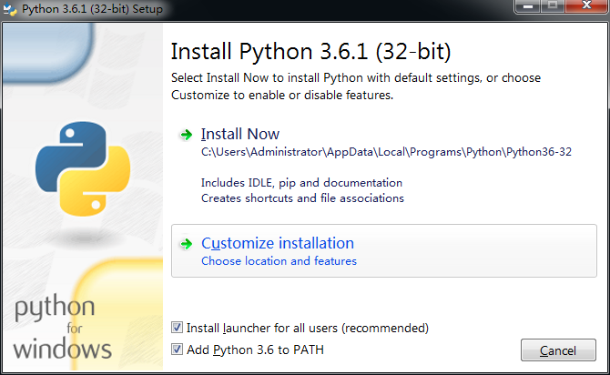
Step1

Slide 20
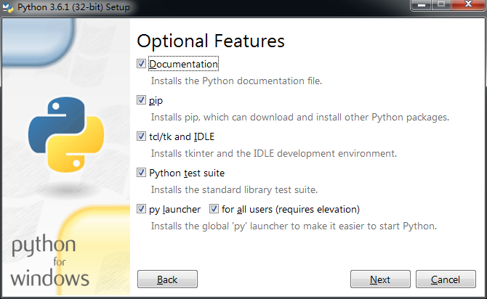
Step2

Slide 21
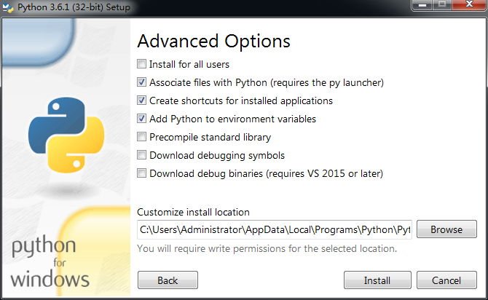
Step3

Slide 22
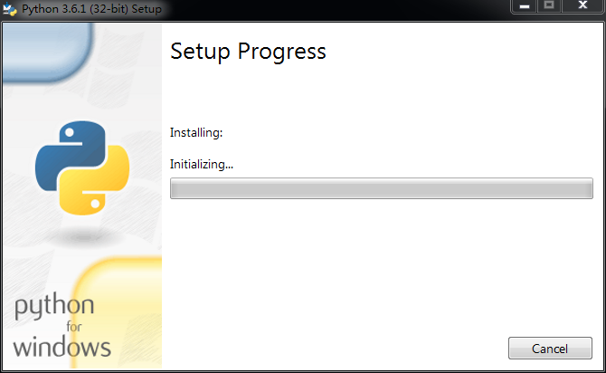
Step4

Slide 23
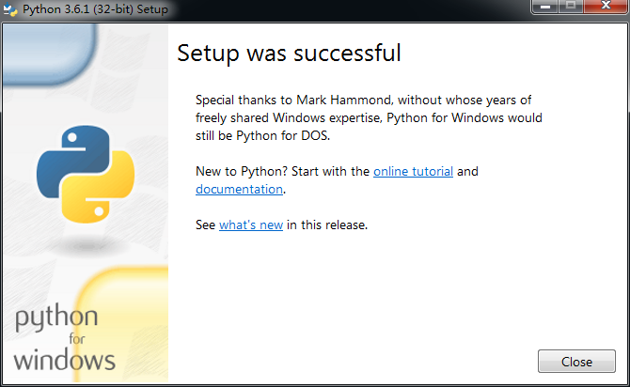
Step5

Slide 24
Hello World
江琳

Slide 25
First Python Program
Let us execute programs in different modes of programming.

Slide 26
Interactive Mode Programming
Terminal – open terminal and type python
$ python
Python 3.6.1 (default, Apr 4 2017, 09:40:21)
[GCC 4.2.1 Compatible Apple LLVM 8.1.0 (clang-802.0.38)] on darwin
Type "help", "copyright", "credits" or "license" for more information.
>>>

Slide 27
Interactive Mode Programming
IDLE
Python 3.6.1 (default, Apr 4 2017, 09:40:21)
[GCC 4.2.1 Compatible Apple LLVM 8.1.0 (clang-802.0.38)] on darwin
Type "help", "copyright", "credits" or "license" for more information.
>>>

Slide 28
Script Mode Programming
Python files have extension .py. Type the following source code in a test.py file:
print(‘Hello World’)
Using terminal and type:
python test.py

Slide 29
Assigning Values to Variables
Python variables do not need explicit declaration to reserve memory space. The declaration happens automatically when you assign a value to a variable. The equal sign (=) is used to assign values to variables.

Slide 30
Assigning Values to Variables
counter = 100 # An integer assignment
miles = 1000.0 # A float
name = 'John' # A string
print (counter)
print (name)
print (miles)

Slide 31
Multiple Assignment
a = b = c = 1
a, b, c = 1, 2, 'John'

Slide 32
Basic Data Types
Integer
Float
String
Boolean
None

Slide 33
Questions?

Slide 34
Tutorial 1

Slide 35
Question 1
Create a program that asks the user to enter their name and their age, then print it out.
Tip: To get user input in Python 3, the command you use is input().

Slide 36
question 2
Create a program that ask user to input, store the input result in a variable, and use it to your heart’s content.
For example:
name = input("Give me your name: ") print("Your name is " + name)

Slide 37
Question 3
Using Script mode to write a program in .py file, then run it in terminal.

